Slide 1
Step 1
We set up their analytics profile set up data transfer through tag manager.
This involves a new GA4 Property and a new Google Tag
Step 2
We have a service account (Google Cloud Platform product) – this is authorised through the GA4 property. (email)
This collects data from GA4 Property into BigQuery
Step 3
Big query takes the data and houses it with all of the other members that have been installed.
We organise the data within bigquery and assign users to the relevant (make it so only their account can access the data (looker), every row gets an email applied)
Step 4
We use Bigqyuery as a data source (views) to generate reports that are displayed in Looker studio
These reports are in two types – email restricted individual data and aggregated data non-identifiable for everyone to see
Step 5 they are given permission nand access to the dashboard to access and view their own data.
https://lucid.app/lucidchart/8a913e31-daf5-48de-88a3-8e2f023668c9/edit?viewport_loc=-613%2C-340%2C2994%2C1391%2C0_0&invitationId=inv_7072c893-be01-48f3-a870-0427d3e11d8e

Slide 2
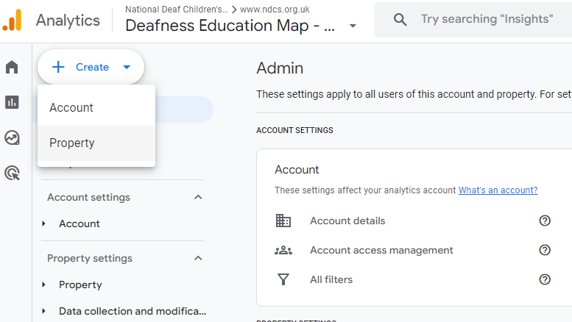
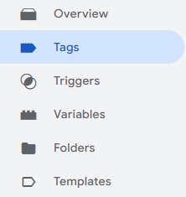


Phase One - Setup
We prepare their GA4 setup and their GTM for integration with the Benchmark.
This involves creating a new property in their GA4 Admin settings, specifically for the benchmark. (We can mirror their specific filters and use our own settings in places we don’t need to mirror)
Then we create a new Google Tag which follows the conventions of their primary Google Tag, being sure to copy any sort of consent setup they have.

Slide 3
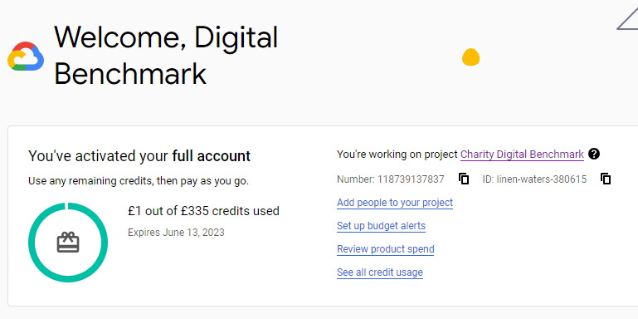
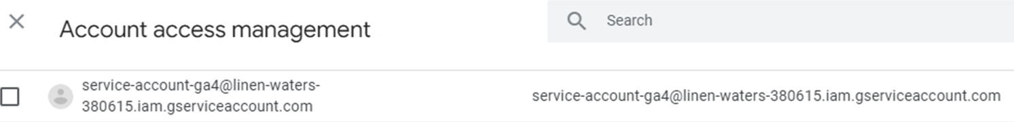

Phase two
We have a service account (Google Cloud Platform product) – this is authorised through the GA4 property.
This collects data directly from the GA4 Property into BigQuery
Data collected
Service Account

Slide 4
Phase three

Slide 5
Phase four

Slide 6
Phase five

Slide 7
Flowchart

Slide 8
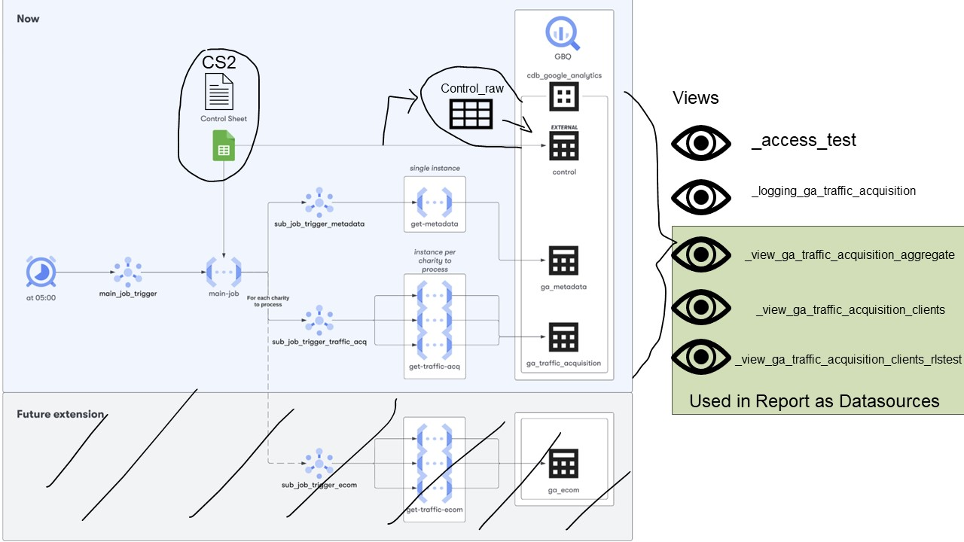

Slide 9
